Slide 1
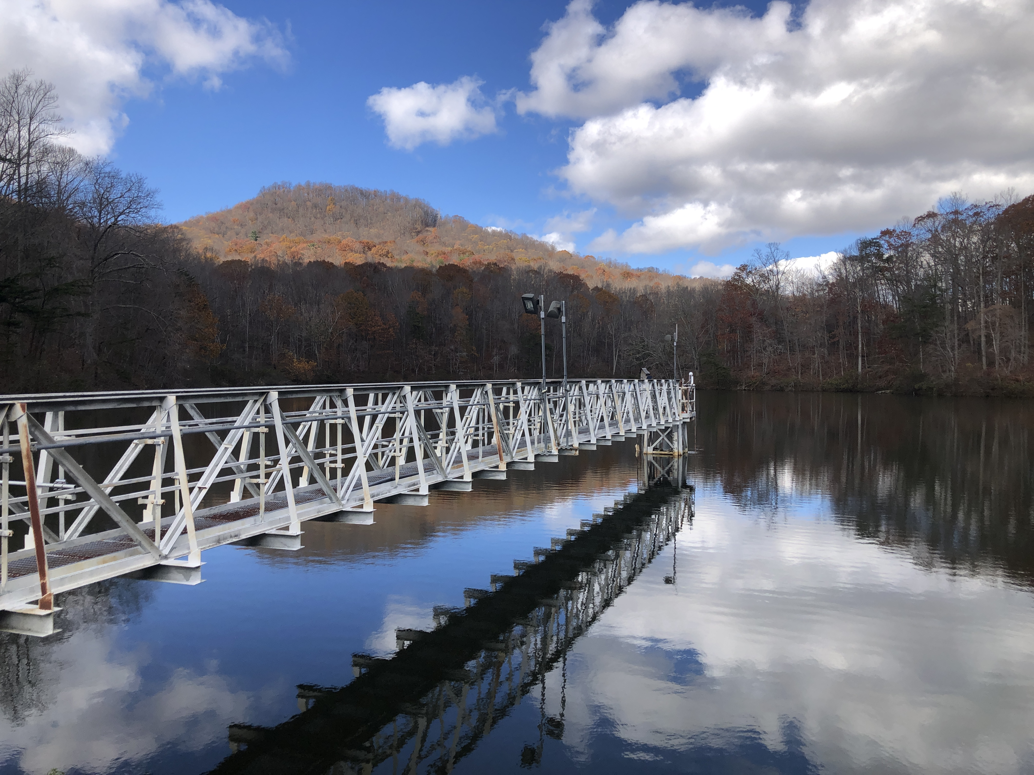
INTEGRATED WHOLE-ECOSYSTEM EXPERIMENTS AND ECOSYSTEM MODELING REVEAL THAT SEASONAL OXYGEN DEPLETION IS DRIVEN PRIMARILY BY TEMPERATURE IN A EUTROPHIC RESERVOIR Abigail Lewis, Ryan McClure, Paul Hanson, and Cayelan Carey
@lewis_lakes
Notes:
Hi, my name is Abby Lewis and today I am going to be talking about a project I led that INTEGRATED WHOLE-ECOSYSTEM EXPERIMENTS AND ECOSYSTEM MODELING to understand SEASONAL OXYGEN DEPLETION IN A DRINKING WATER RESERVOIR

Slide 2
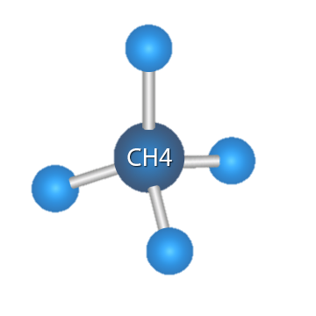
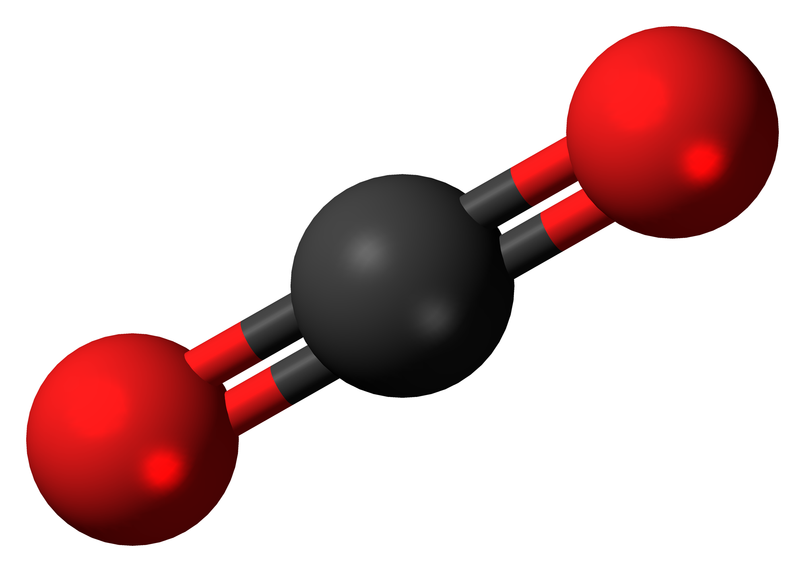
Hypolimnetic oxygen demand is closely tied to water quality and carbon cycling
75% of human water use comes from rivers, lakes, and reservoirs
Reservoirs alone bury more carbon than ocean sediments each year (Dean and Gorham 1998; Knoll et al. 2013)
The extent to which reservoirs perform either of these functions depends on oxygen demand
CO₂
Notes:
I want to start off by emphasizing that oxygen demand, or the rate of hypolimnetic oxygen depletion, is closely tied to a variety of important ecosystem services in lakes and reservoirs
75% of human water use comes from a combination of rivers, lakes, and reservoirs, so it is important that we conserve these freshwater resources.
And reservoirs also play a critical role in the global carbon cycle. Each year, reservoirs around the world bury more organic carbon than all ocean sediments. This serves as an important and understudied ecological carbon sink.
The extent to which reservoirs are able to perform either of these important functions depends on oxygen demand
High rates of biological oxygen demand mean that more carbon is being mineralized, increasing GHG production and potentially increasing carbon emissions from reservoirs. High rates of oxygen demand can also cause oxygen concentrations to decrease to the point where you see deteriorating water quality or release of nutrients such as nitrogen and phosphorus which cause harmful algal blooms.

Slide 3


Oxygen demand (both biological and chemical) is dependent on temperature and ambient oxygen concentrations, among other factors
O₂
Notes:
Oxygen demand contains both biological and chemical components. Biological oxygen demand occurs as a result of respiration that consumes oxygen, while chemical oxygen demand results from oxidation of reduced substances and can also play an important role in determining the overall rate of oxygen consumption.
From previous research, we know that both biological and chemical oxygen demand are dependent on temperature and ambient oxygen concentrations, among other factors
Temperature increases oxygen demand by accelerating biological and chemical processes that consume oxygen,
likewise increased oxygen availability can accelerate diffusion of oxygen into anoxic sediment and release oxygen limitation of bacterial respiration, all increasing the rate of oxygen demand

Slide 4






Changes in climate and land use are driving divergent trends in oxygen demand
[O₂]
[O₂]
Notes:
It is difficult to predict how the rate of oxygen demand will change over time in a given body of water, in part because changes in climate and land use are having divergent effects on oxygen demand.
Water temperatures in the upper layer of a lake or reservoir are generally increasing around the world, potentially increasing the rate of oxygen demand and decreasing oxygen concentrations.
At the same time, bottom-water temperatures are generally decreasing as a result of increased shading from dissolved organic carbon, which would decrease the rate of oxygen demand and lead to higher oxygen concentrations.
Increased storm frequency and intensity can directly increase oxygen concentrations in lakes and reservoirs
And finally changes in land use and climate are driving eutrophication, which can increase oxygen demand and decrease oxygen concentrations
In light of these heterogeneous changes, it is important that we understand the relative importance of temperature and oxygen concentrations as drivers as oxygen demand, so that we can predict how water quality and carbon cycling in reservoirs, will change over time.

Slide 5


More information is needed to determine how these factors interact in lakes and reservoirs
≠
Notes:
Finally, it is worth noting that most previous research that has been done on oxygen demand has been done in small-scale incubations, making it difficult to assess how these factors will interact on an ecosystem-wide scale

Slide 6
How do temperature and oxygen interact to determine the rate of oxygen demand at the scale of a whole reservoir?
Notes:
Consequently, our focal question for this study was “How do temperature and oxygen interact to determine the rate of oxygen demand at the scale of a whole reservoir?“

Slide 7
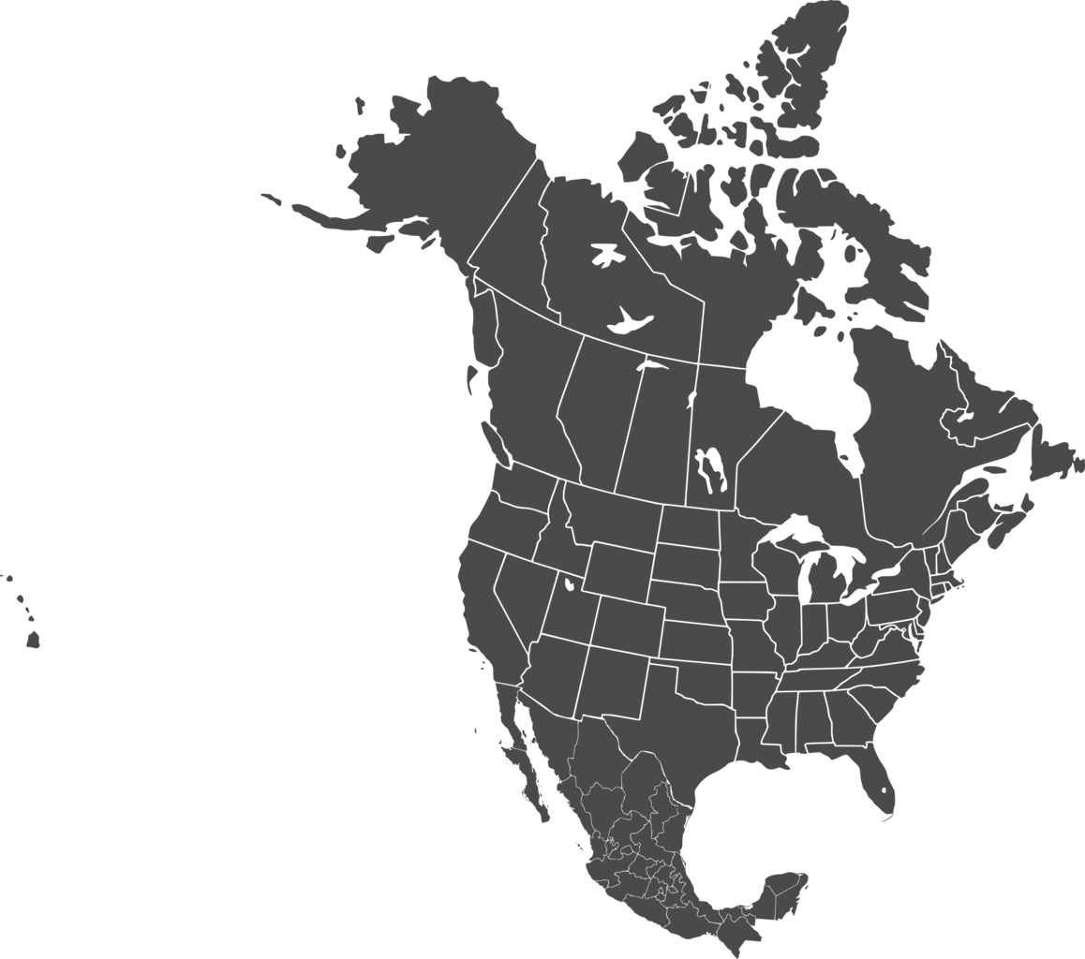

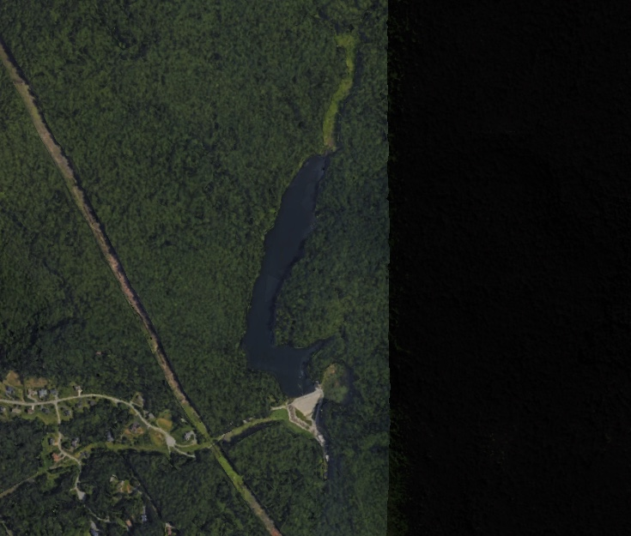
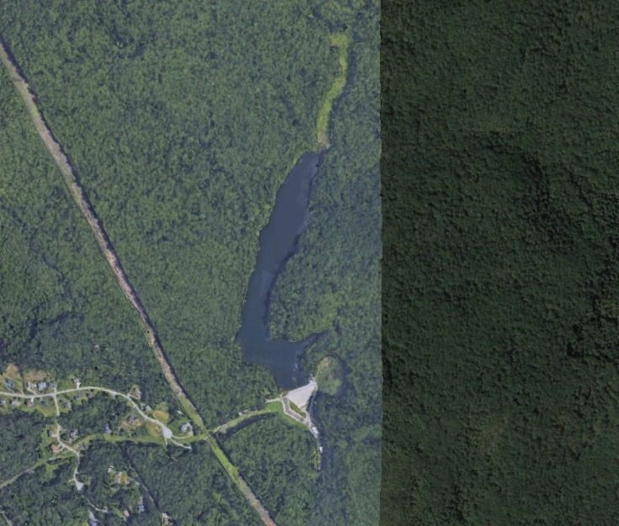
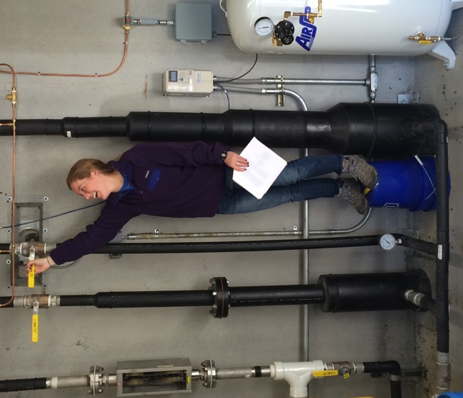

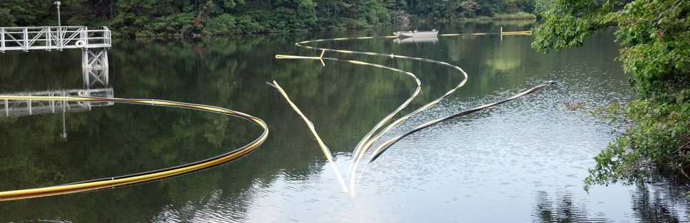
Eight years of oxygenation have provided a unique opportunity to analyze these factors on a whole-ecosystem scale
Falling Creek Reservoir
1 km
Notes:
To address this question, I used data from Falling Creek Reservoir, which is located in Southwest VA. Falling creek is a useful study site for this question, because it is equipped with a hypolimnetic oxygenation system that allows us to experimentally alter oxygen concentrations in the bottom waters of the reservoir, without decreasing thermal stability.
You can see that oxygenation system in this picture at the bottom. The oxygenation system operates at the bottom of the reservoir, but we had a perfect photo opportunity when we brought the system up to the surface for maintenance.
Oxygenation can be turned on and off on demand by scientists and managers, as shown in the picture above.
Starting in 2013, this oxygenation system has been operated on a variable schedule, providing a perfect dataset that disentangles seasonal correlations between oxygen concentrations and temperatures, helping us isolate the separate impacts of oxygen and temperature on oxygen demand.
And I want to give a huge shout out to the western virginia water authority for allowing us to work in their reservoir and perform these whole-ecosystem experiments over the past 8 years

Slide 8
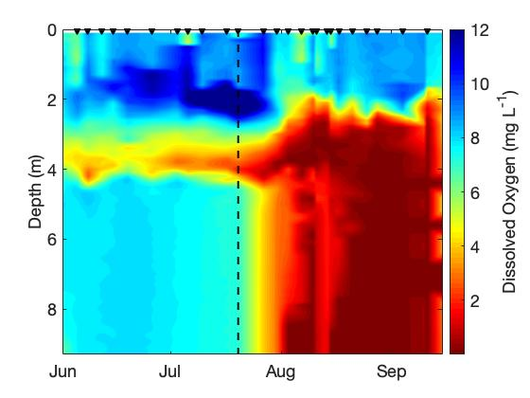
Oxygenation is effective at increasing hypolimnetic oxygen concentrations
Falling Creek Reservoir 2018
ON
OFF
Notes:
In this figure, you can see that oxygenation really is effective at increasing hypolimnetic oxygen concentrations
... In this figure I am only showing data from 2018 for the purpose of illustration, but I also used data from 2013 to 2020 in my analysis

Slide 9
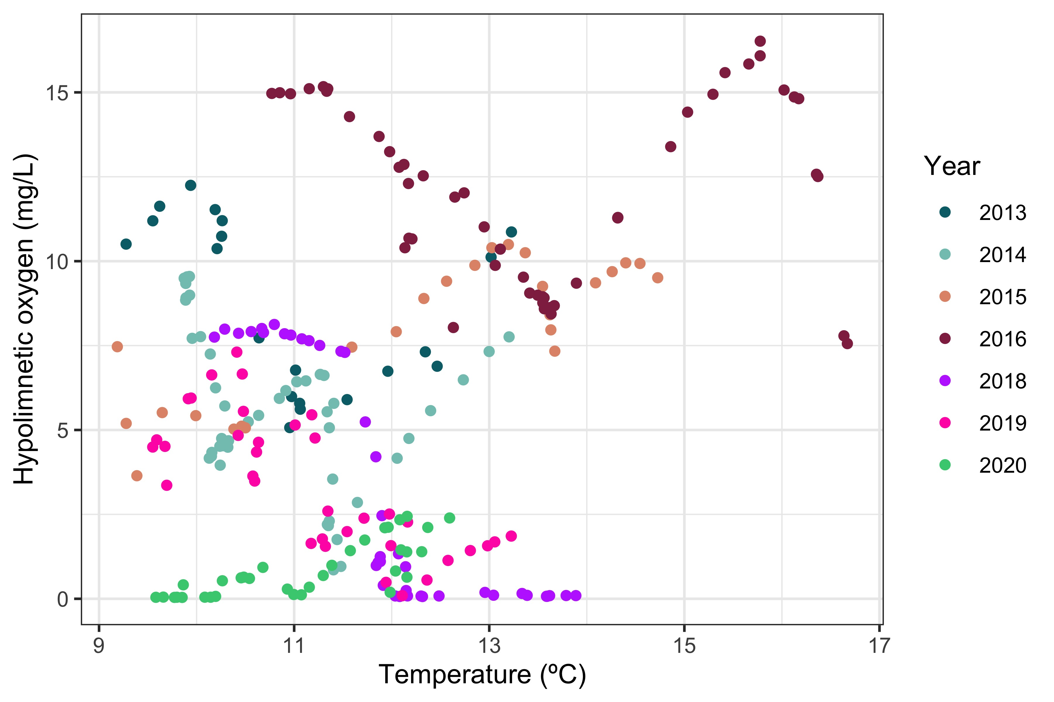
Oxygen manipulations disentangled seasonal correlation between temperature and oxygen
Spring
Summer
Notes:
…
You’ll notice data from 2017 are excluded from this figure. This is due to equipment failure that limited temperature and oxygen data availability in that year.

Slide 10
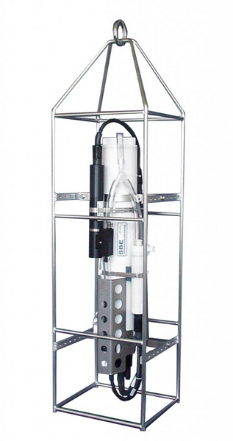
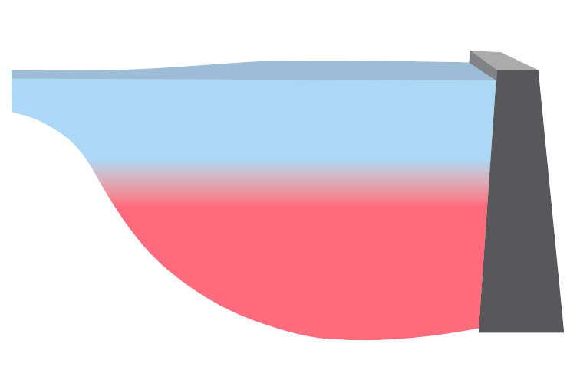
Volume-weighted hypolimnetic dissolved oxygen and temperature were calculated using twice-weekly high-frequency depth profiles
Notes:
The data in this figure are all volume-weighted hypolimnetic measurements, which I will use throughout the rest of my talk. These concentrations are calculated from twice-weekly CTD casts, which provide high frequency temperature and oxygen measurements, in addition to a wide variety of other data. Profiles were collected at the deepest point in the reservoir. We then used reservoir bathymetry to calculate a volume-weighted concentration of oxygen and an average water temperature throughout the entire hypolimnion.

Slide 11
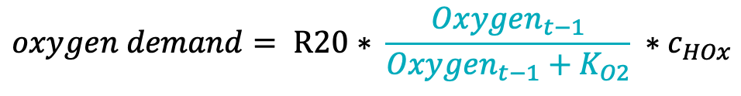
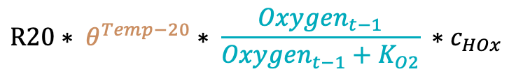
Alternative model structures test the importance of two drivers of oxygen demand
Full model
Oxygenation System
Oxygen Demand
$${DO}_{t}={DO}_{t−1}+HOx −oxygen demand$$
O₂
O₂
O₂
$$R20∗ θ^{Temp−20}∗ \frac{{Oxygen}_{t−1}}{{Oxygen}_{t−1}+K_{O2}} ∗c_{HOx}$$
Temperature-only model
Oxygen-only model
$$oxygen demand= R20∗ \frac{{Oxygen}_{t−1}}{{Oxygen}_{t−1}+K_{O2}} ∗c_{HOx}$$
$$oxygen demand= R20∗ θ^{Temp−20} ∗c_{HOx}$$
Training: 2013–2017 (parameters selected using CMAES). Test: 2018–2020
Notes:
To analyze these data, we created a model of oxygen demand, where oxygen demand is dependent on….
We then took the original model that contained sensitivity to both temperature and oxygen, and I divided it into two separate models to analyze the dominant drivers of oxygen demand. The temperature-only model included temperature as a driver, but not oxygen concentrations, and the oxygen-only model included oxygen as a driver, but not temperature. We chose this process-based approach rather than typical multiple linear regression approaches due to the substantial body of literature which has suggested these non-linear relationships between temperature, oxygen, and oxygen demand.

Slide 12
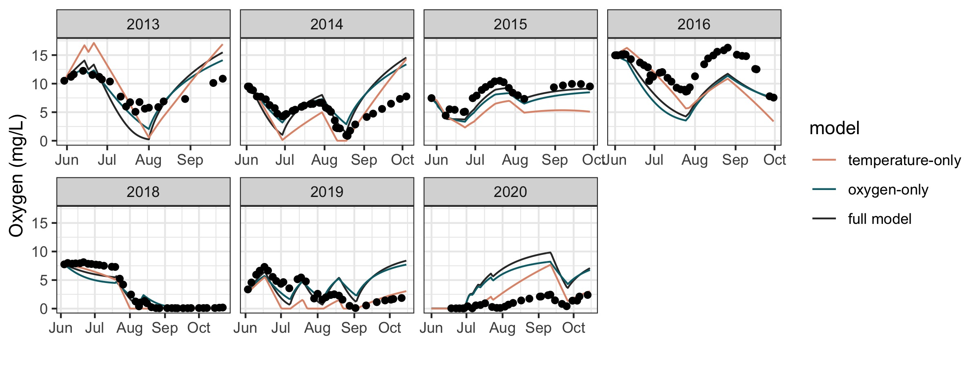
Temperature-only model outperforms oxygen-only model and full model in test years
Notes:
In this figure you can see observations (plotted as points) compared to model predictions (plotted as lines) over the entire time series of data.
Training vs testing
temperature only model does best at recreating the late summer oxygen increases, while the other models underestimate oxygen demand and over-estimate concentrations in that time period

Slide 13
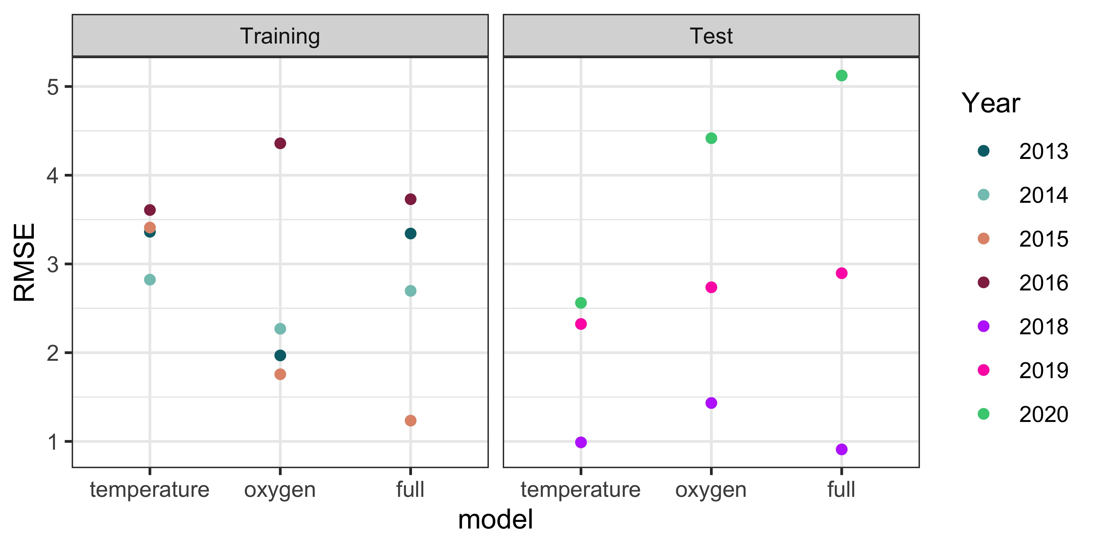
Temperature-only model outperforms oxygen-only model and full model in test years
Notes:
Anoxic period makes it more predictable in 2018
COD leads to issues in 2019, 2020

Slide 14
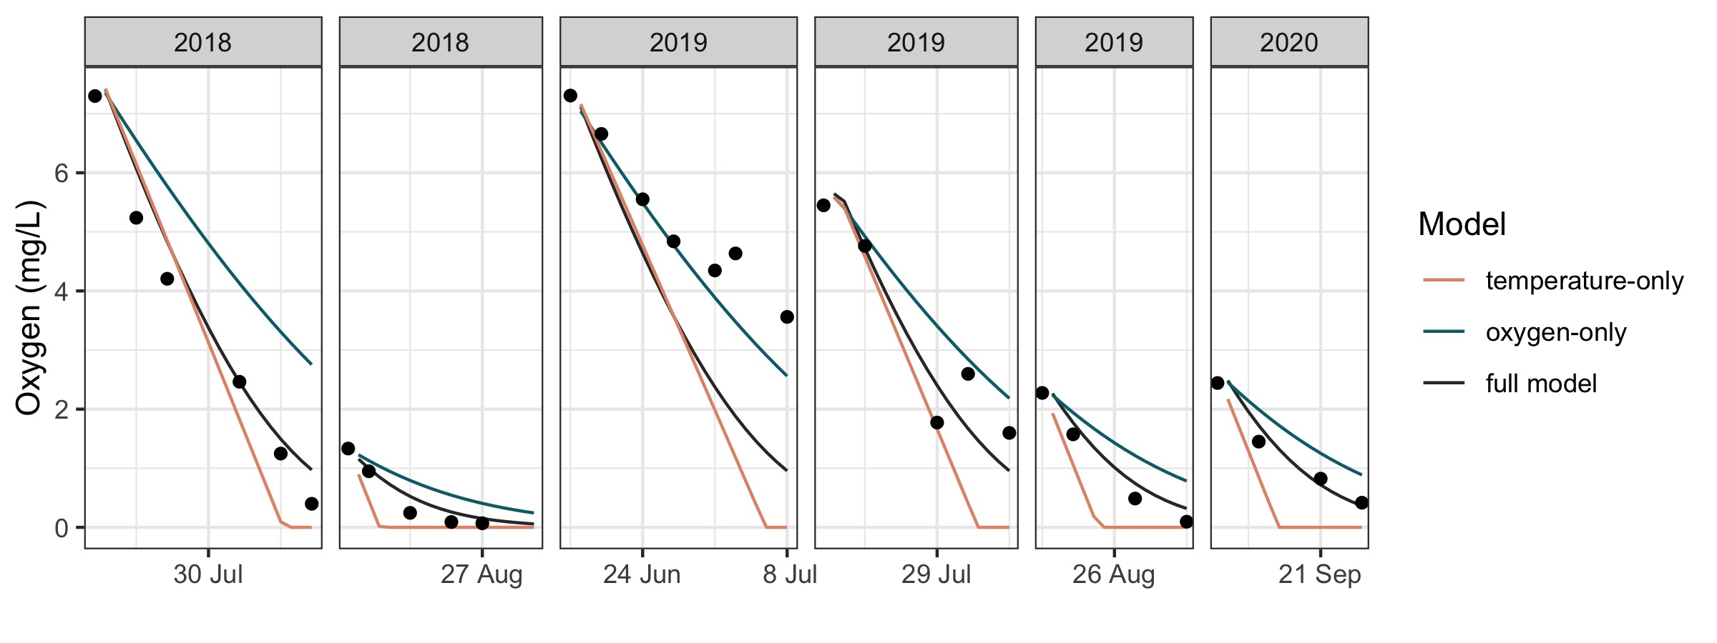
Oxygen concentration may be an important driver of oxygen demand in the absence of oxygenation
Notes:
Finally, we performed a separate analysis of oxygen demand during only the periods where the oxygenation system was not activated from 2018 to 2019. So each of these panels represents a period of approximately two weeks where the oxygenation system was not activated. All three models were set to the same initial concentration of oxygen, and then we tracked their predictions throughout the onset of anoxia. Interestingly, you can see here that the full model and oxygen-only model actually do better at recreating changes in oxygen over time during these periods. This agrees with previous research, which has found that the oxygenation-induced oxygen demand may be sensitive to temperature. Overall, these results suggest that while oxygen does not play a significant role in determining the rate of oxygen demand averaged over entire seasons, there may be periods of time where oxygen concentrations are in fact an important control on the rate of oxygen demand in lakes and reservoirs

Slide 15
Conclusions
Changing temperatures may dramatically alter oxygen conditions in lakes and reservoirs
Oxygen demand may be sensitive to oxygen concentrations in the absence of oxygenation
Next steps:
Refine model comparison process
Incorporate chemical oxygen demand
Notes:
So overall, through this project we have found that the temperature-only model performed better than either the oxygen-only model or the full-model, suggesting that changing temperatures may dramatically alter oxygen conditions in lakes and reservoirs.
However, notably, oxygen appeared to play a more important role in determining the rate of oxygen demand during un-oxygenated intervals, suggesting that oxygen demand may be sensitive to oxygen concentrations in the absence of oxygenation
Moving forward, I am now working to
Refine model comparison process considering additional models and further exploring the circumstances under which each model performs best
Incorporate chemical oxygen demand, which may be driving poor model performance under oxic conditions
While more work is needed, through this project, we have already begun to develop a better understanding relative importance of temperature and oxygen concentrations as drivers as oxygen demand on a whole ecosystem scale. Through this work we are helping to better predict how water quality and carbon cycling in reservoirs, will change over time.

Slide 16



aslewis@vt.edu
@lewis_lakes
Notes:
I want to thank the Carey lab for collecting all of these data over the past six years, and the western Virginia water authority for allowing us to do work in their beautiful reservoirs. Thanks everyone for listening, and I’m happy to take any questions!

Slide 18
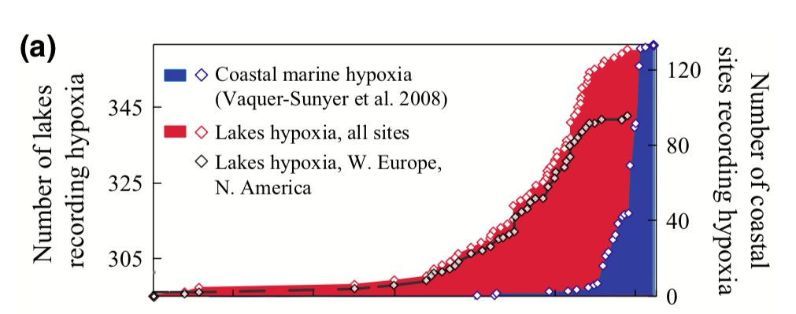
Jenny et al. (2016)

Slide 19
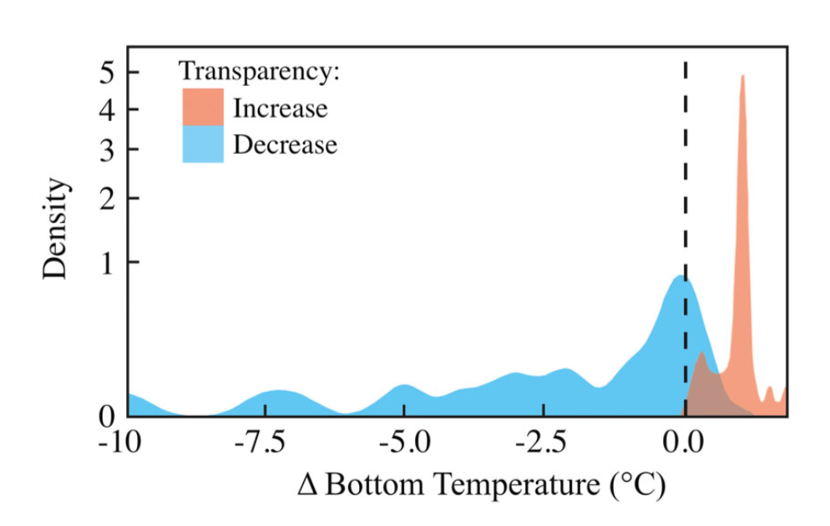
Heterogeneous global changes have led to uncertainty about future oxygen dynamics

Slide 20

Changes in climate and land use are driving heterogeneous trends in oxygen demand
O₂
O₂
O₂

